Slide 1
Data Analytics Course
#class-material

Slide 2
Objectives
Recap
Introduce Numpy
Numpy Arrays and Dimensions
Ufuncs
Broadcasting
Notes:
Recap Functions and operators <>, =,

Slide 3
numpy

Slide 4
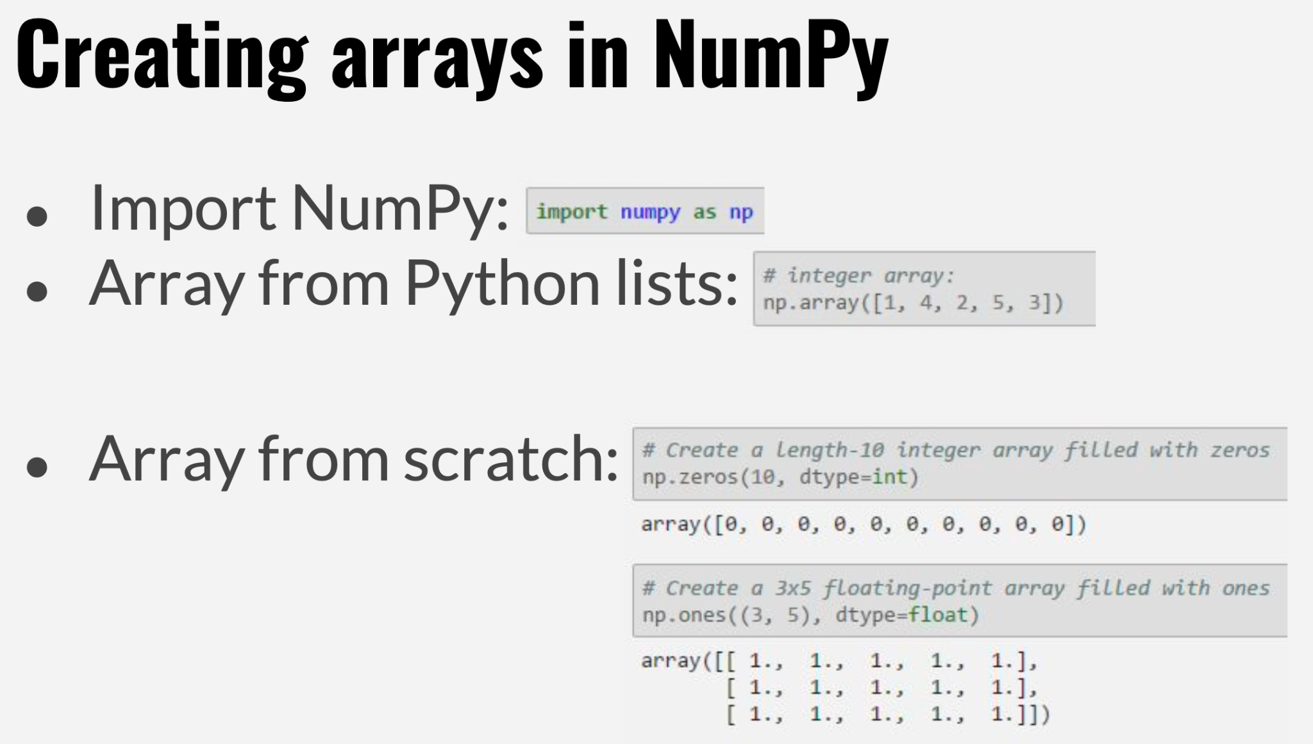
Data Analytics Course

Slide 5
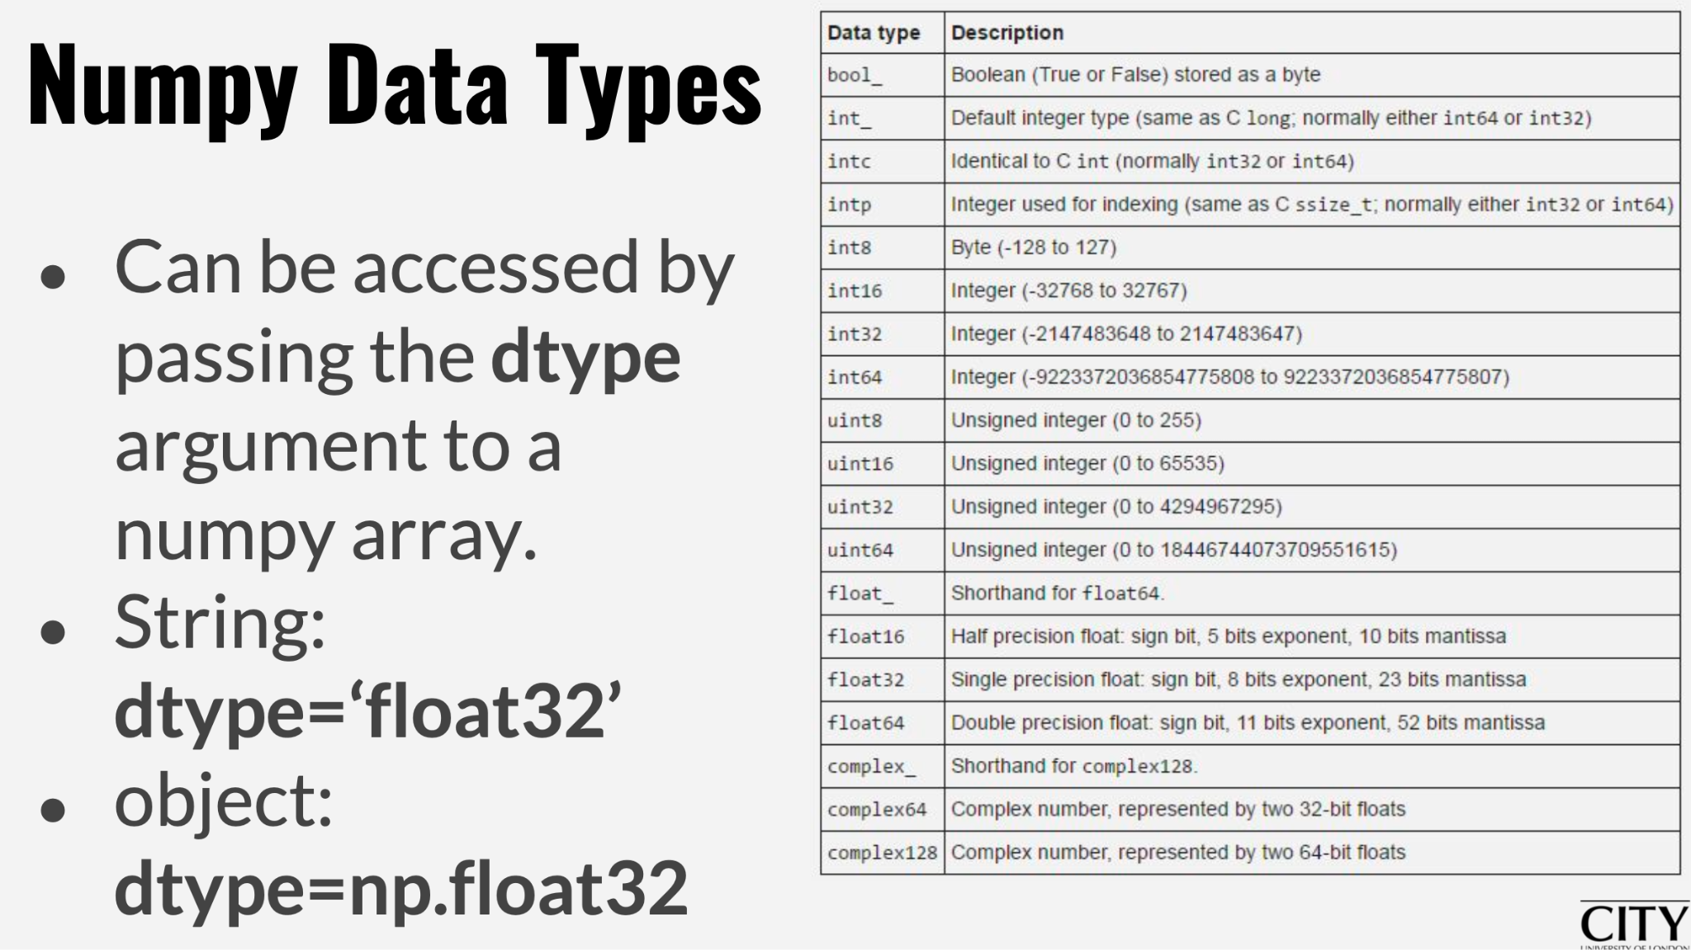
Data Analytics Course

Slide 6
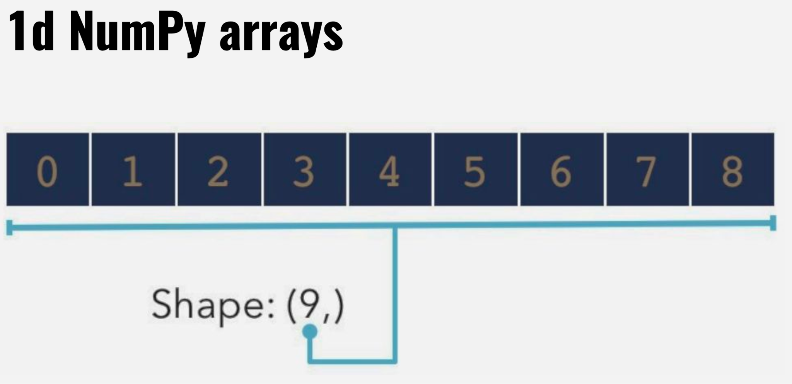
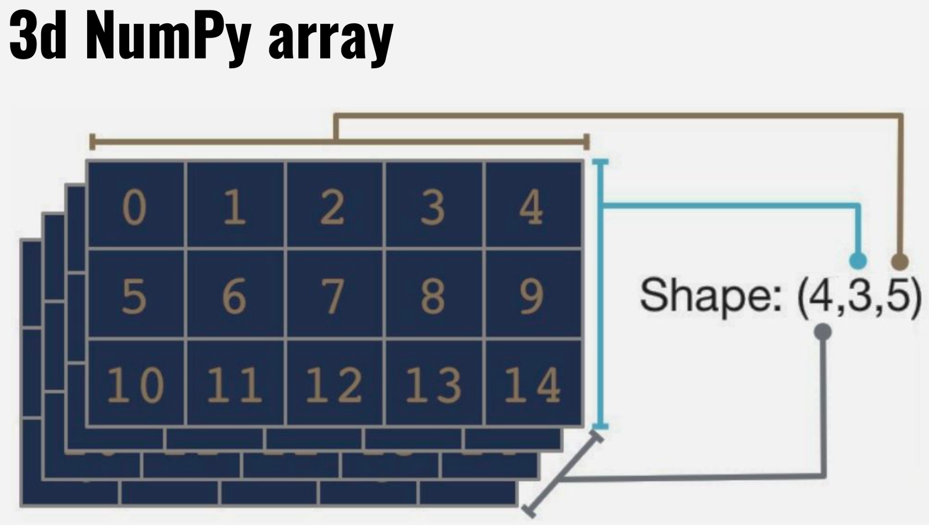
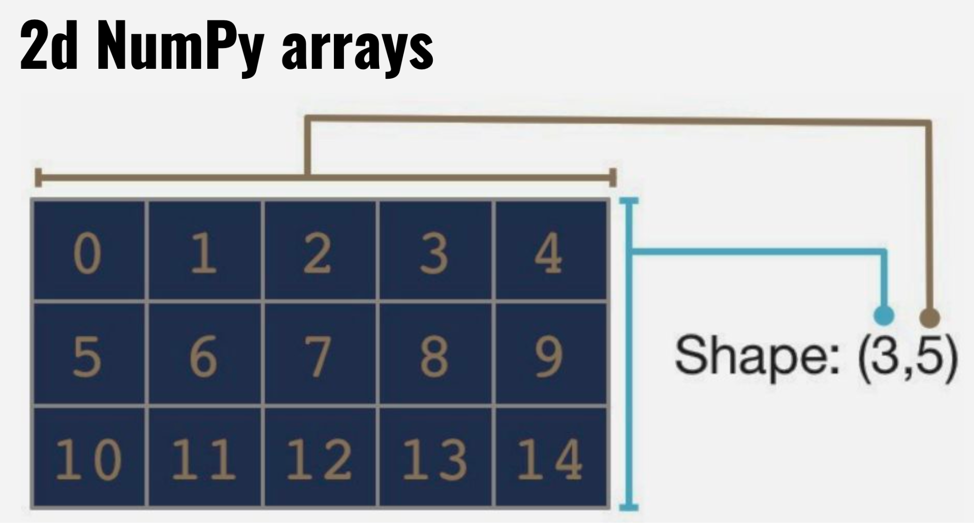
Data Analytics Course
Dimensionality
Notes:
np.random.randint(10,size=(2,5,2))

Slide 7
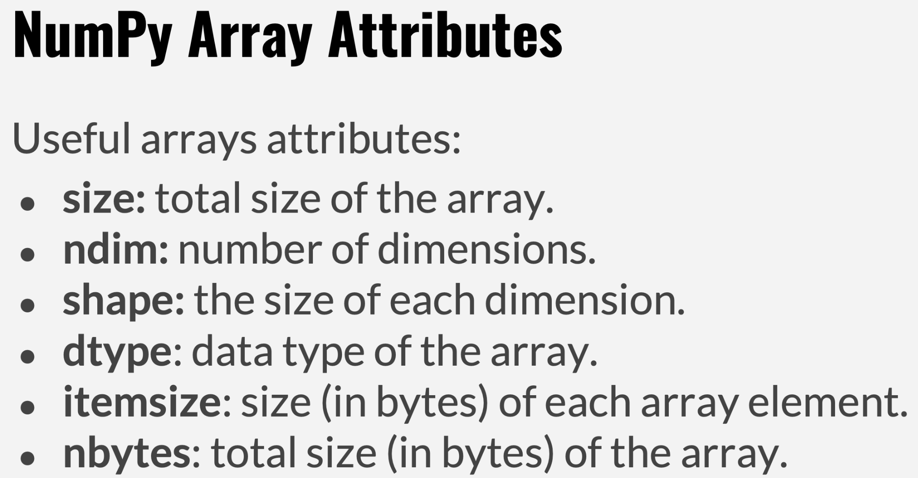
Data Analytics Course

Slide 8
let’s try it out
> LIVE DEMO: numpy in Colab <
Notes:
-- SELECT traffic_source,
-- count(id) as nr_users,
-- FROM `bigquery-public-data.thelook_ecommerce.users`
-- GROUP BY traffic_source
-- ORDER BY nr_users desc
-- select count(*) from `bigquery-public-data.thelook_ecommerce.users`
SELECT traffic_source,
count(id) as nr_users,
(select count(*) from `bigquery-public-data.thelook_ecommerce.users`) as tot_users,
FROM `bigquery-public-data.thelook_ecommerce.users`
GROUP BY traffic_source
ORDER BY nr_users desc;

Slide 9
classes

Slide 10
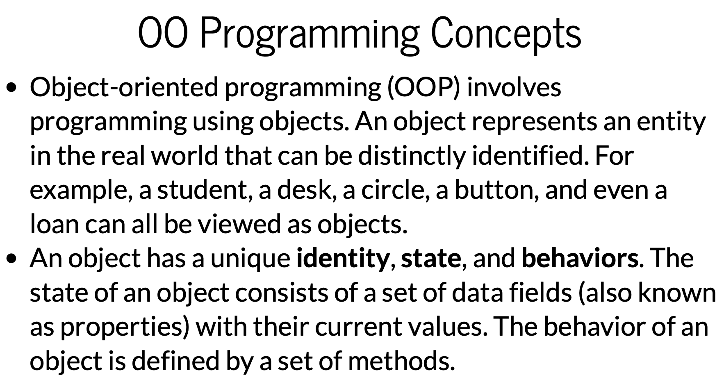
Data Analytics Course

Slide 11
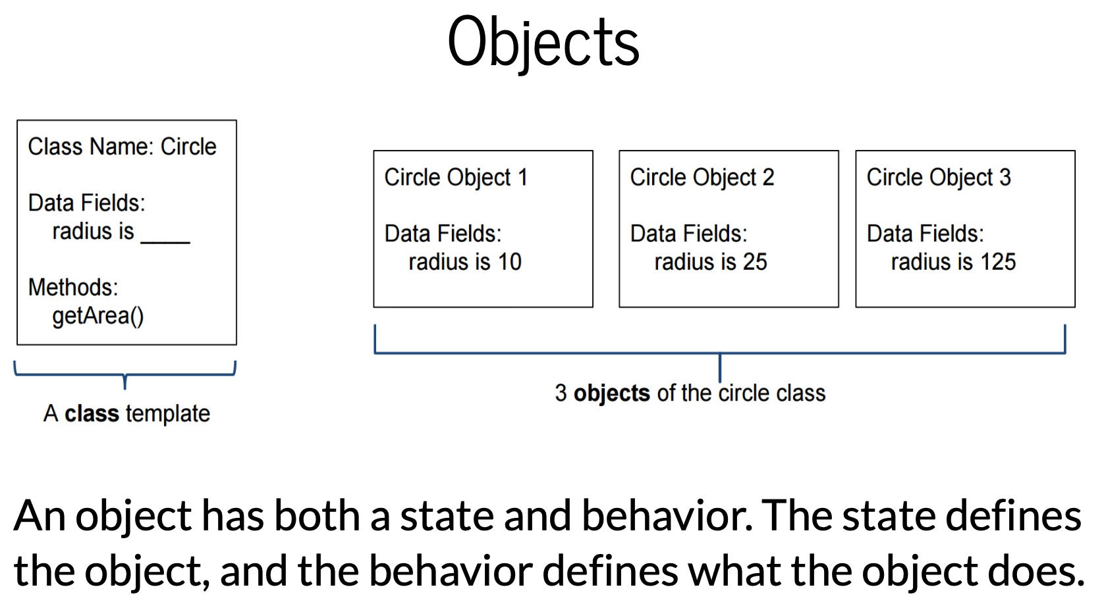
Data Analytics Course

Slide 12
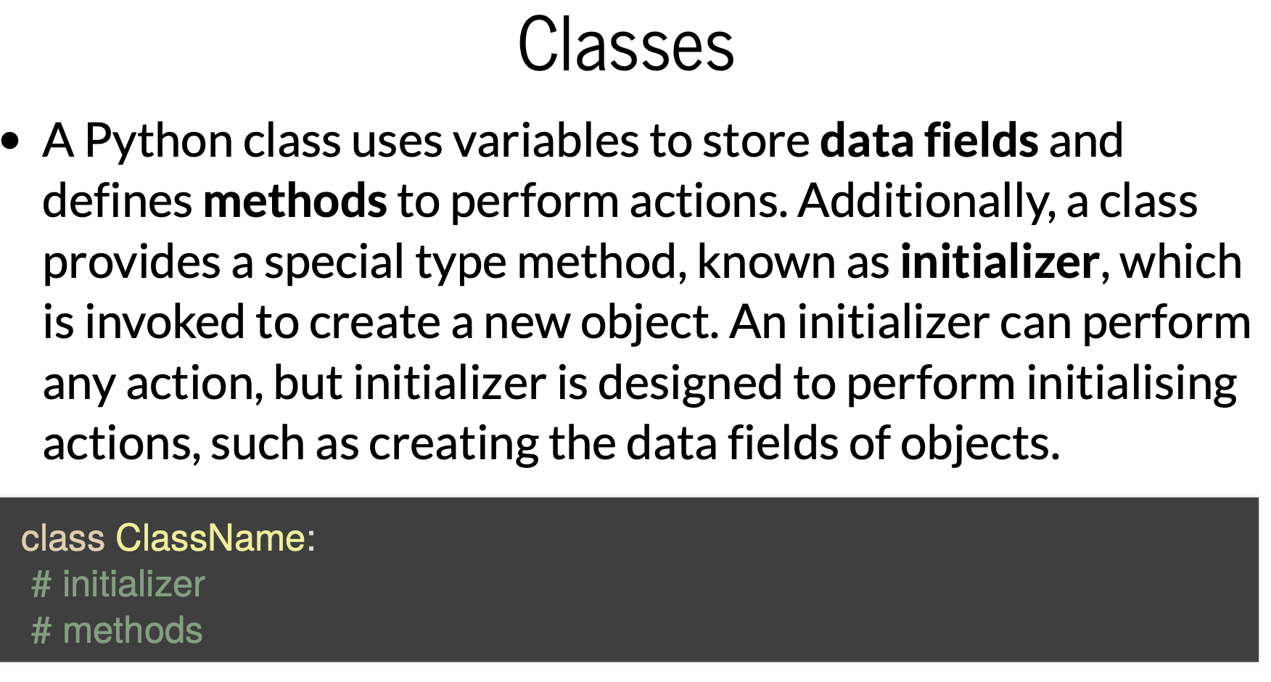
Data Analytics Course

Slide 13
Data Analytics Course

Slide 14
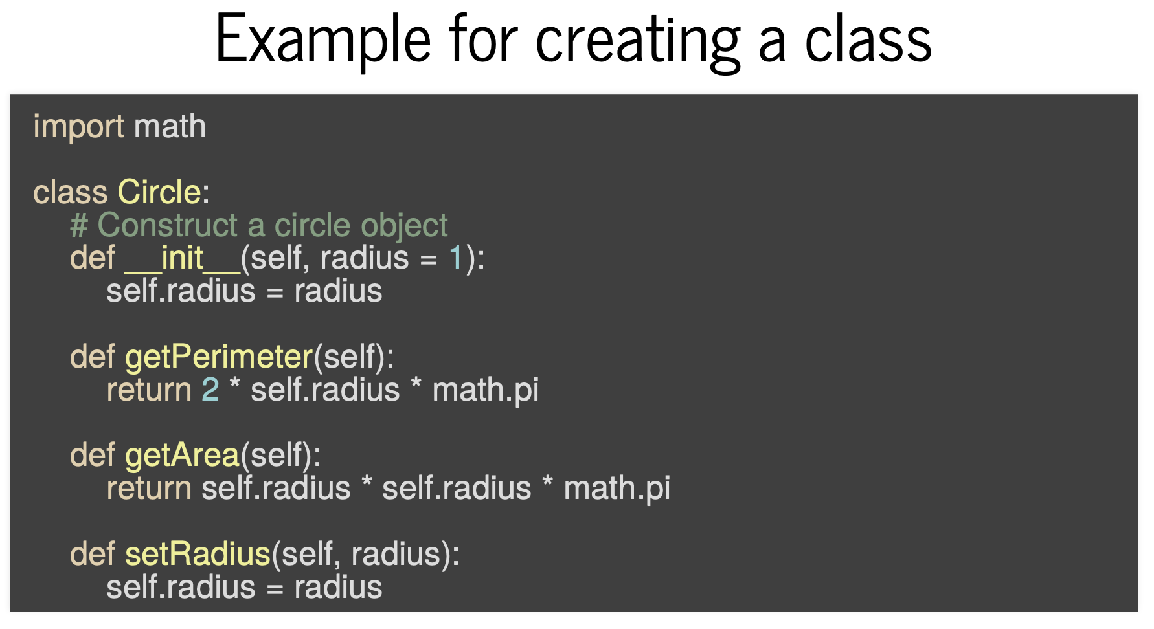
Data Analytics Course

Slide 15
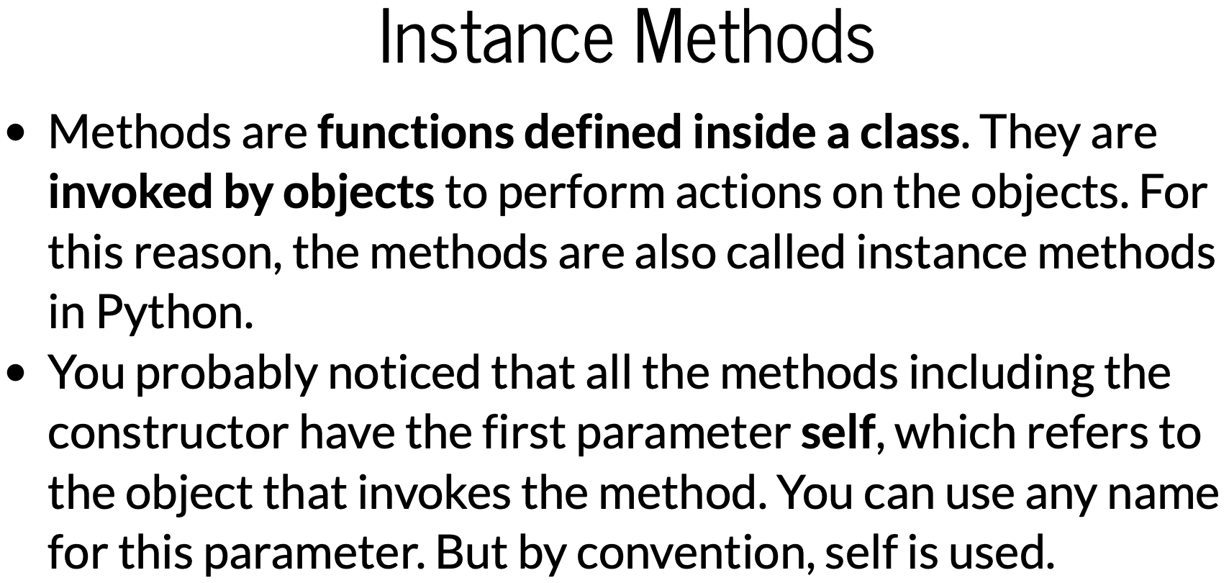
Data Analytics Course

Slide 16
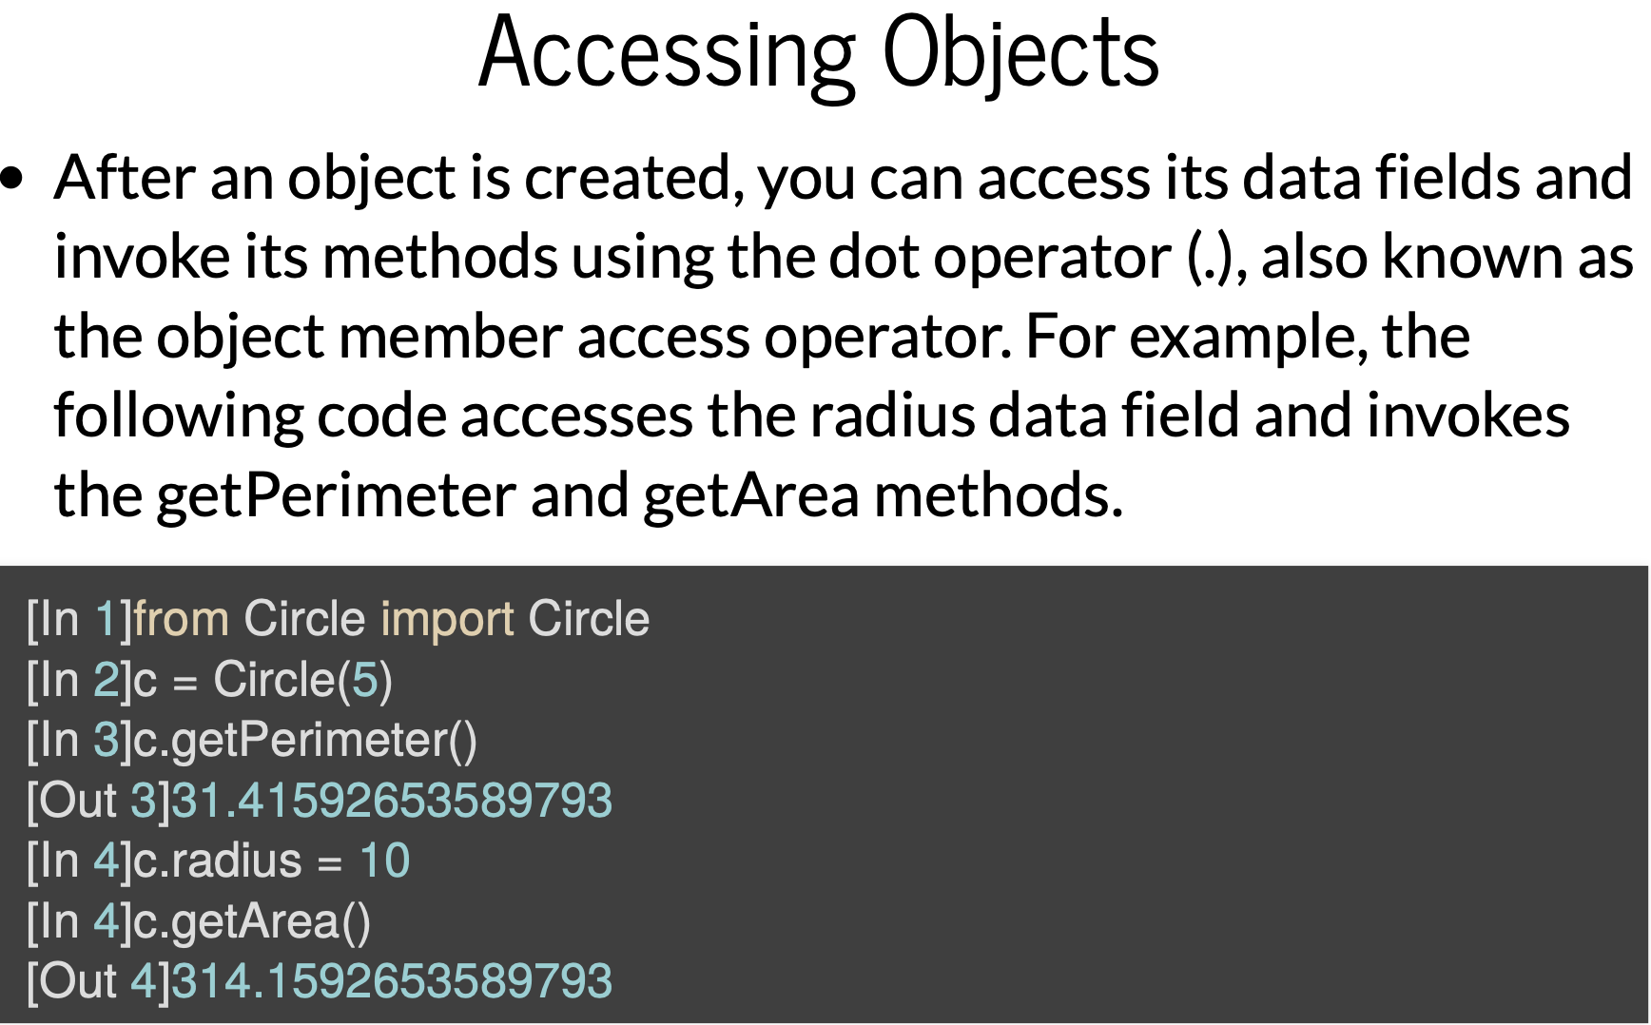
Data Analytics Course

